Slide 1


DRGN Studio Technical Review Presentation
Members: Aaron Hazzard #95455, Raushawn Mitchell #94804

Slide 2

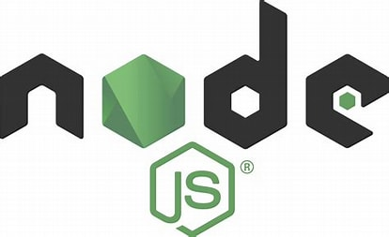

Language Used
Language was changed from Django framework to node.js and mySQL to handle backend functionality

Slide 3

Description of System
Ne1 Freelance is a professional web-based freelancing platform built using node.js. It will be used by users who would like to provide freelancing gigs(freelancers) and users who would like to source freelancing gigs(clients).

Slide 4
Functional Requirements
Login/ Signup For Users(Login and Signup Pages Created)
Create Jobs( Create Jobs Form Created)
Create Service Categories(Admin Page Form Created)
Change User Information and Add Profile Picture(User can change account information and add a profile picture on profile page)

Slide 5
Potential Usability Concerns
Mobile Optimization(It is hard to properly optimize a website to align neatly on various mobile device sizes)

Slide 6
Components Planned to Be Completed
Search System
Chat Feature
Contact Page
Any Other necessary admin page forms

